Slide 1
BELLABEAT PROJECT:
How can a wellness technology company play it smart?
Tippawan BILLS
5/9/2022

Slide 2
About bellabeat
Bellabeat is a high-tech company that manufactures health-focused smart products: BeallaBeat App, Leaf wellness tracker, Wellness watch, Spring water bottle.
Collecting data on activity, sleep, stress, and reproductive health has allowed Bellabeat to empower women with knowledge about their own health and habits.

Slide 3
Objective
To identify trends of how Bellabeat customers use their smart devices and then use these trends to inform Bellabeat marketing strategy.

Slide 4
Public data that explore smart device user’s daily habits
Data were collected from 30 users from 4/12/2016 to 5/12/2016
The data contain daily activity, step, heart rate, and sleep monitoring
Data sources
Data source: FitBit Fitness Tracker Data | Kaggle

Slide 5
Data tables used
dailyActivity
sleepDay
hourlyIntensity
hourlyCalories

Slide 6



Data Analysis Tools
Data cleaning and analysis
Data visualization
This Photo by Unknown Author is licensed under CC BY

Slide 7
Data Cleaning using MS SQL
After uploading data to MS SQL, the followings were checked to ensure that the data is clean.
The number of total rows and columns are correct
Data has a consistent format
There are any duplicates data
Data has a correct data type

Slide 8
Data Processing in MS SQL
1
Insert ‘Day of week’ column into DailyAcitivity table
2
Left join DailyActivity table with SleepDay table
3
Inner join HourlyCalories and HourlyIntensity table.
4
Extract time from ActivityHours.
5
Export data into Excel sheets and use Tableau for data visualization.

Slide 9
What did we find?

Slide 10
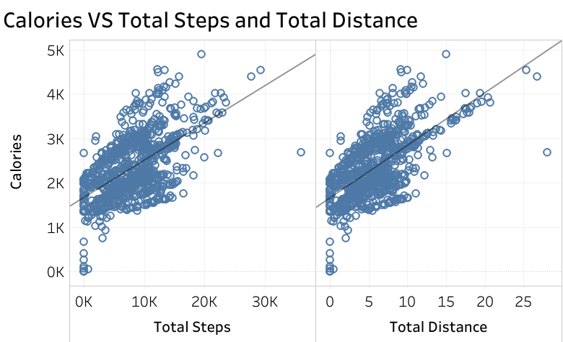
Calories burned have a positive correlation with steps and total distance
The more step and distance users go, the more calories burned.

Slide 11
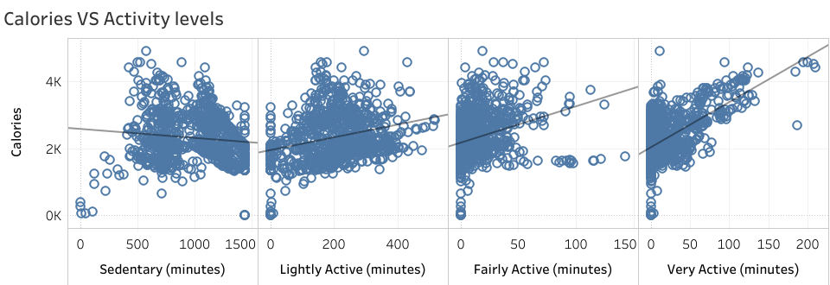
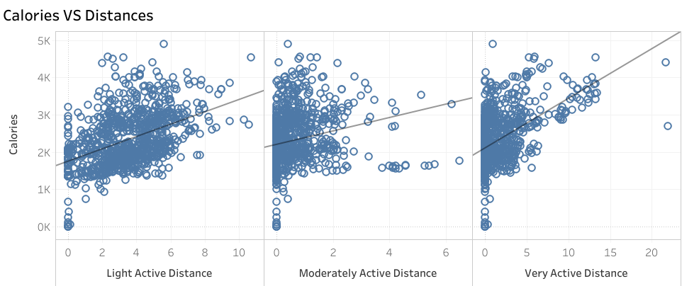
The very active activity has the strongest correlation with calories burned.
Sedentary has the weakest correlation with Calories
burned

Slide 12
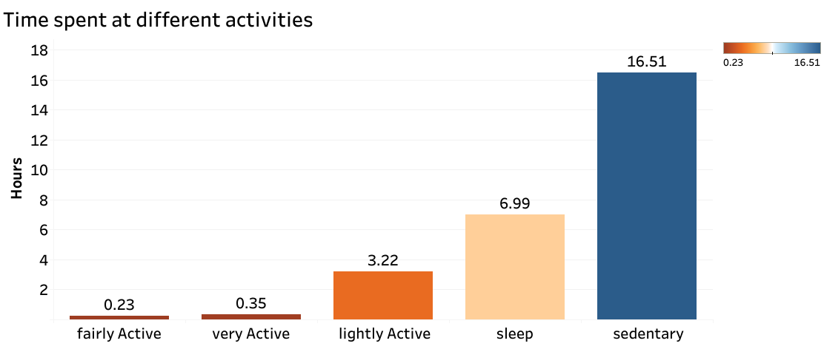
The users spent most of their time on inactive activity (avg.16.5 hours per day)

Slide 13
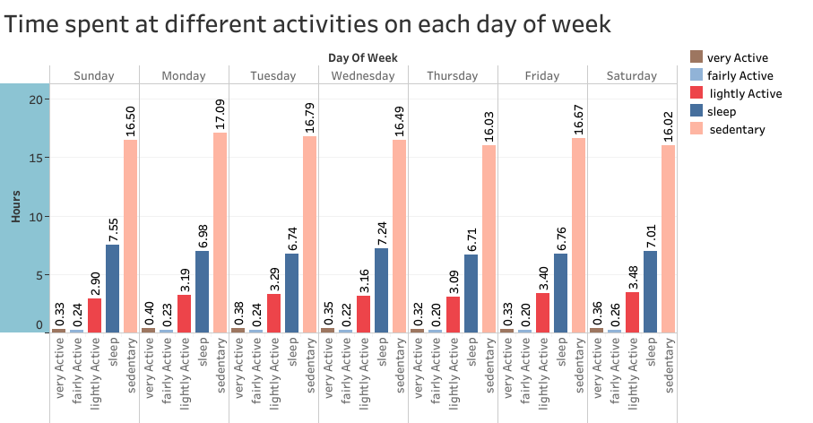
There is no significantly difference in amount of time spent in each day of week in each activity levels

Slide 14
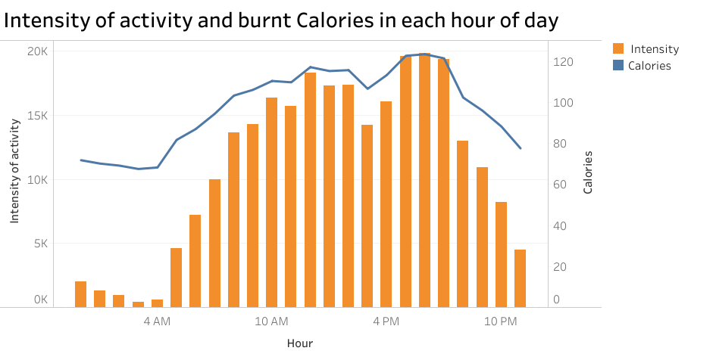
The highest intensity of activity occurred between 5 PM to 7 PM in each day

Slide 15
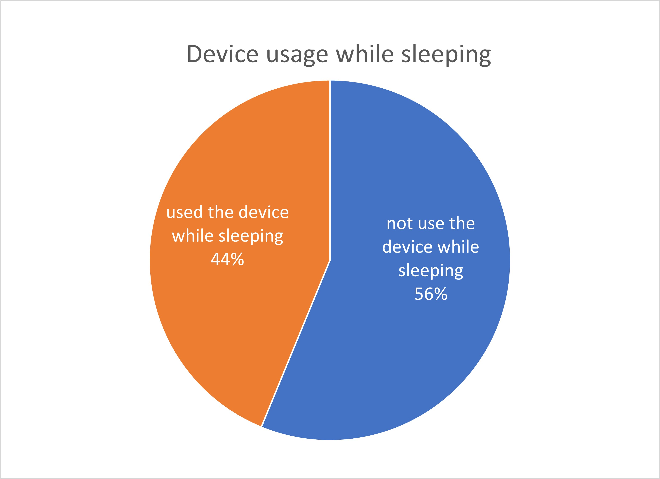
There was only 44% occurrence that users used their smart devices while sleeping

Slide 16
Conclusions
1
The data confirms that the more users spent time on the very active activities, the more calories burned.
2
Users spent most of their time in the inactive activities, presuming a lot of users are office workers.
The highest intensity activity occurs at the time after work, supposedly because the users go on exercise after work.
3
4
Less than half of the time users used their smart device while sleeping.

Slide 17
recommendations
Since the users spent a lot of time on inactive activities, design an app with on screen real-time metrics will help users stay motivated on exercise.
Design an app with guided workout types that are effective, and users can do it easily at home after work.
Design devices that are comfortable to wear while sleeping.

Slide 18
Thank you

Slide 19
BellaBeat Project
File created on: 5/9/2022 5:15:40 PM

